Slide 1
In project management, a network diagram is a visual representation of the sequence and interdependencies of project activities
It provides a graphical view of the project schedule, illustrating the flow and relationships between different tasks or activities.
Network diagrams are particularly useful for understanding the critical path of a project, identifying dependencies, and planning the most efficient schedule.
Components of a Network Diagram:
Nodes (or circles): Represent events or milestones in the project. These could be the start or finish of an activity.
Arrows (or lines): Represent activities or tasks. The arrows connect nodes to illustrate the sequence in which activities should be performed.
Duration Estimates: Associated with each arrow to represent the time it takes to complete a particular activity.
Dependencies: Indicate the relationships between different activities, showing which activities must be completed before others can start.
Critical Path: The longest path through the network, representing the minimum time required to complete the project. Activities on the critical path have no float or slack.

Slide 2
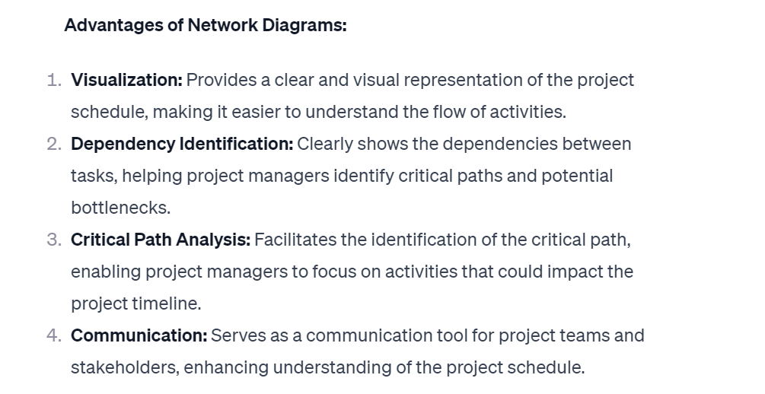

Slide 3
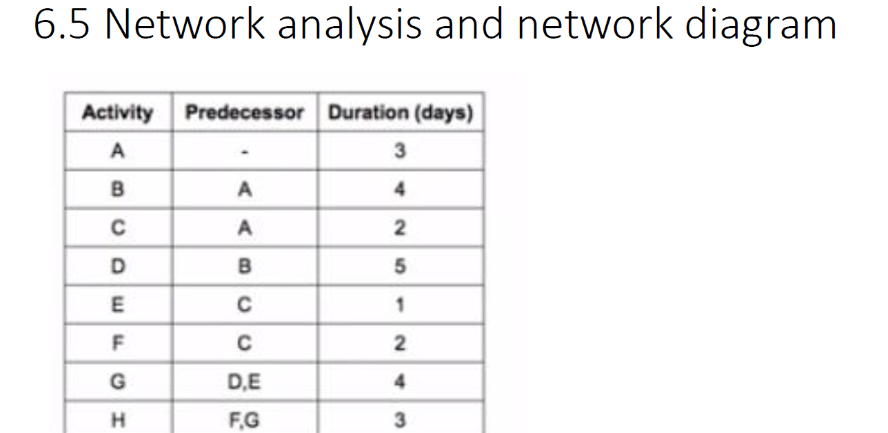

Slide 4
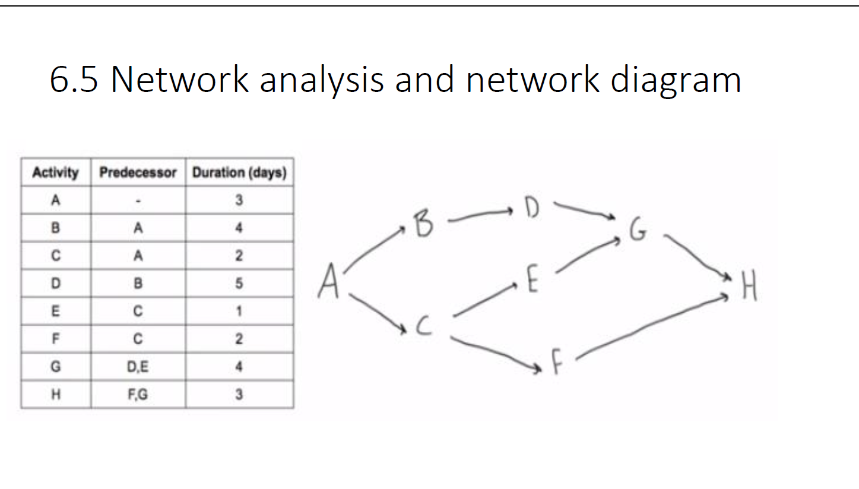

Slide 5
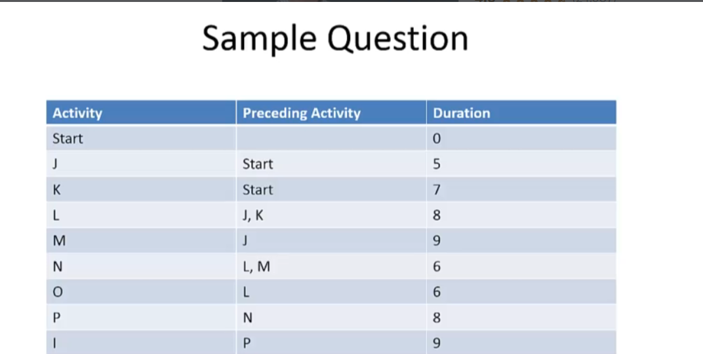

Slide 6
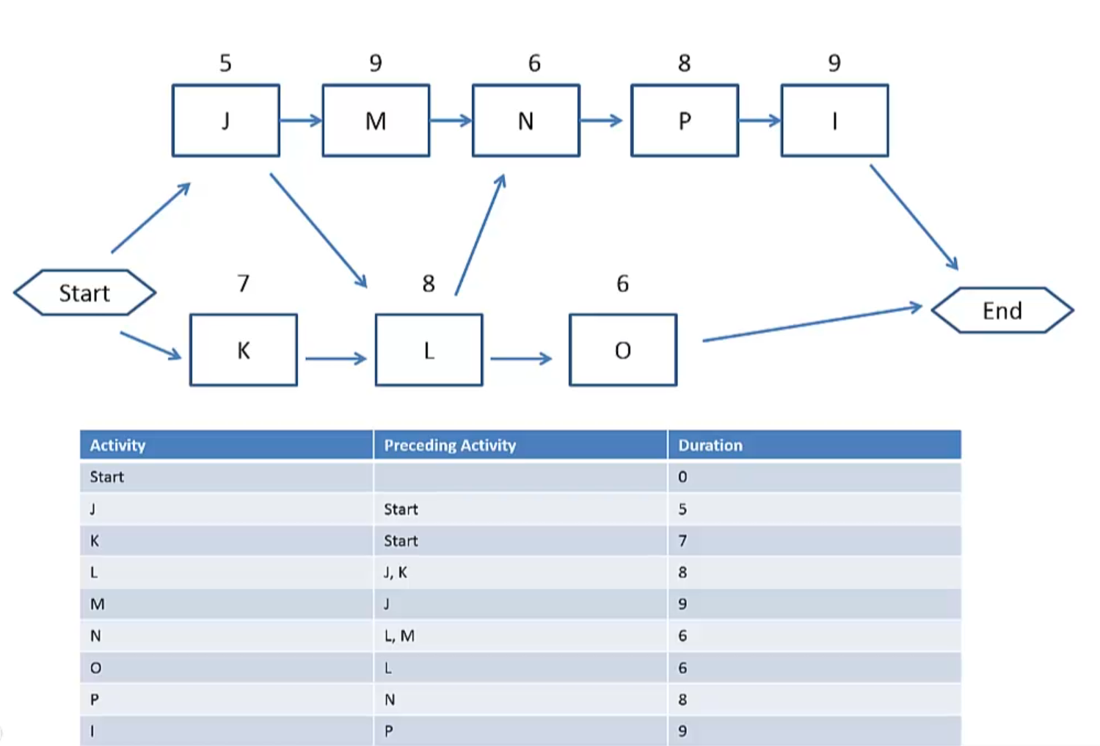

Slide 7
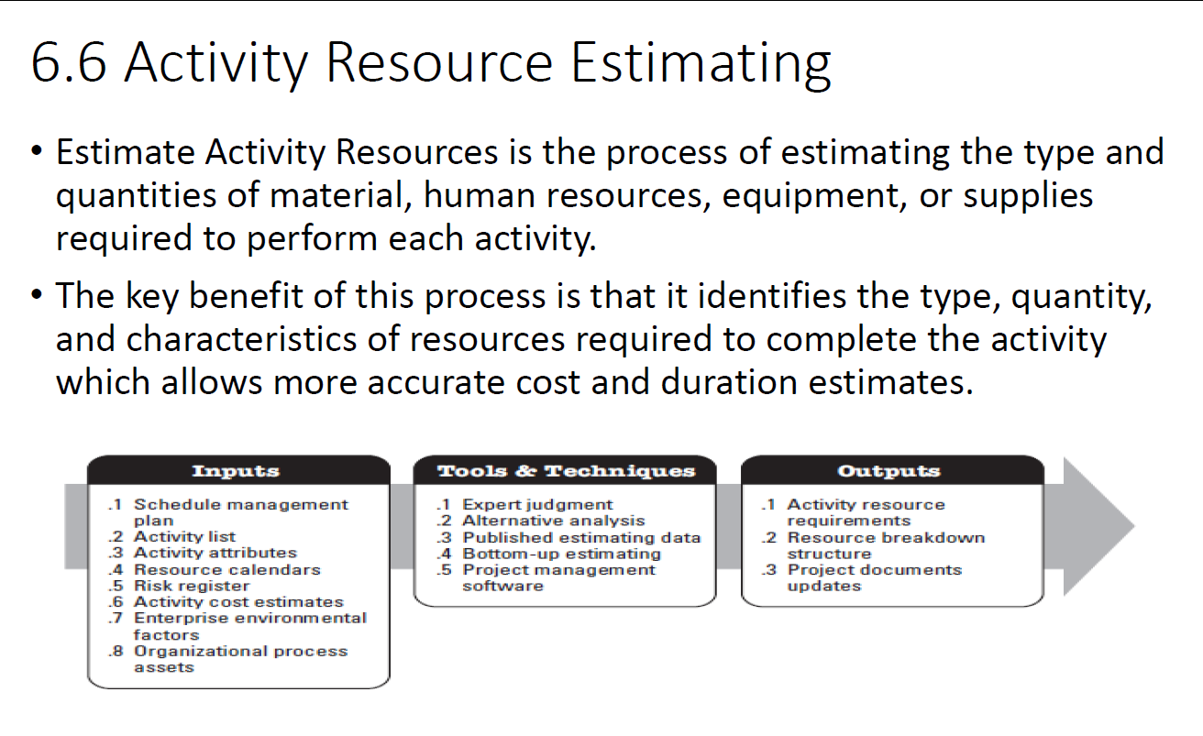

Slide 8
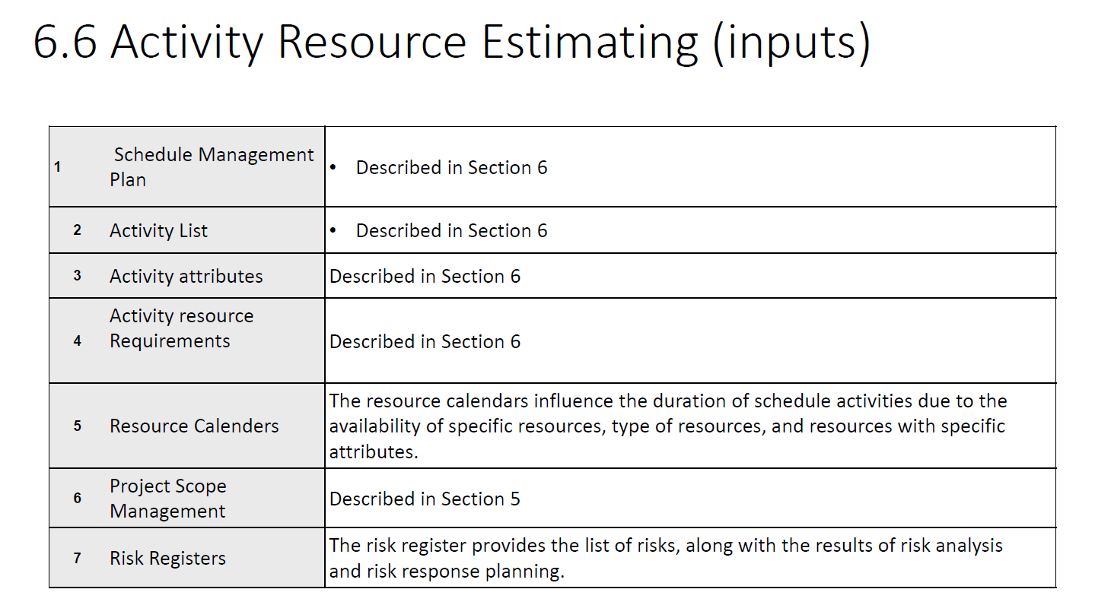

Slide 9
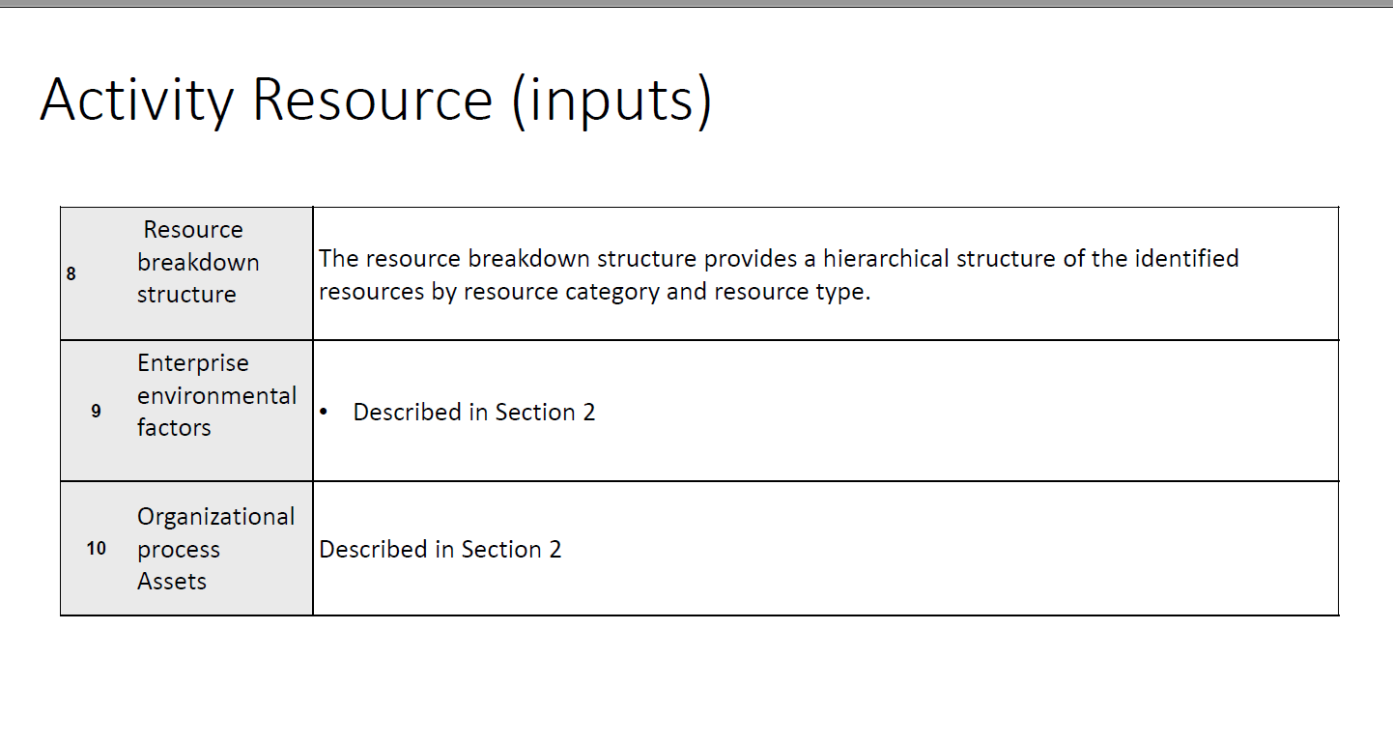

Slide 10
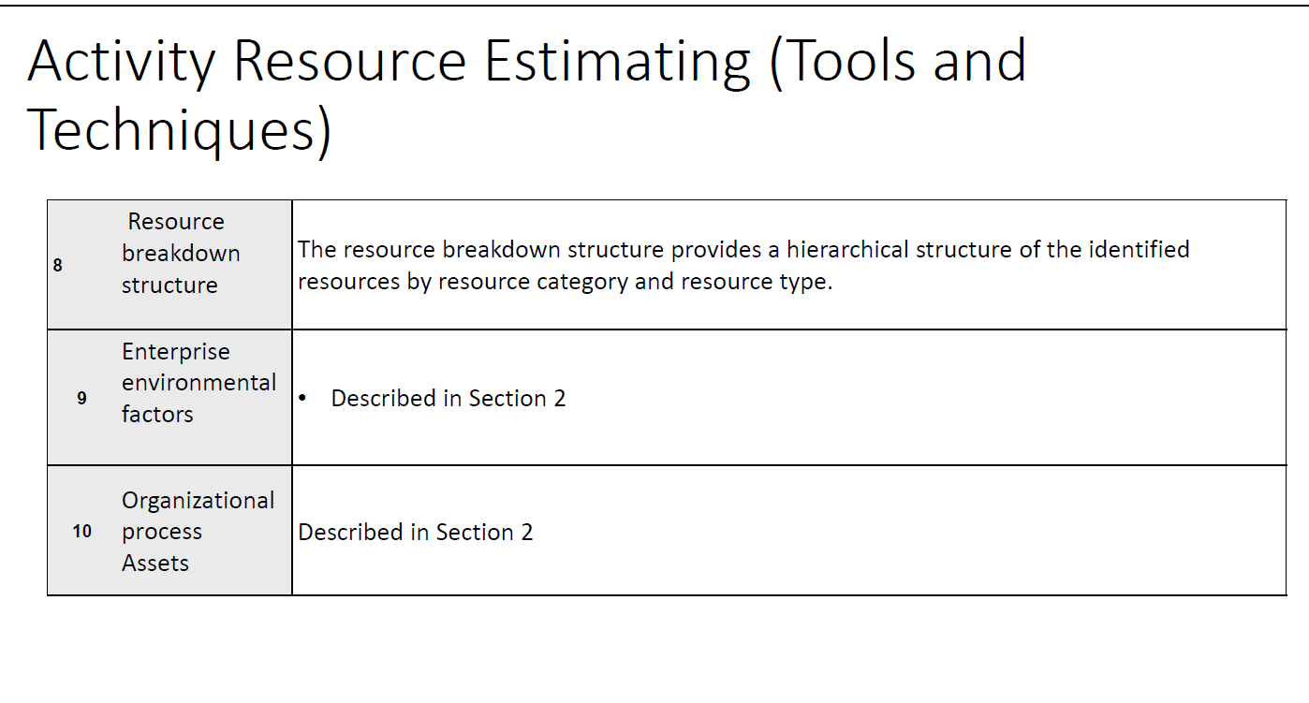

Slide 11
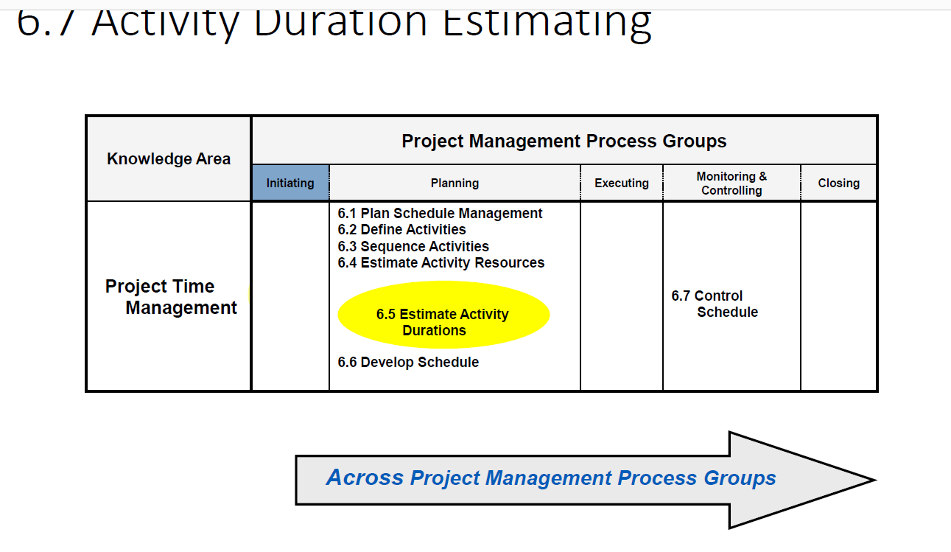

Slide 12
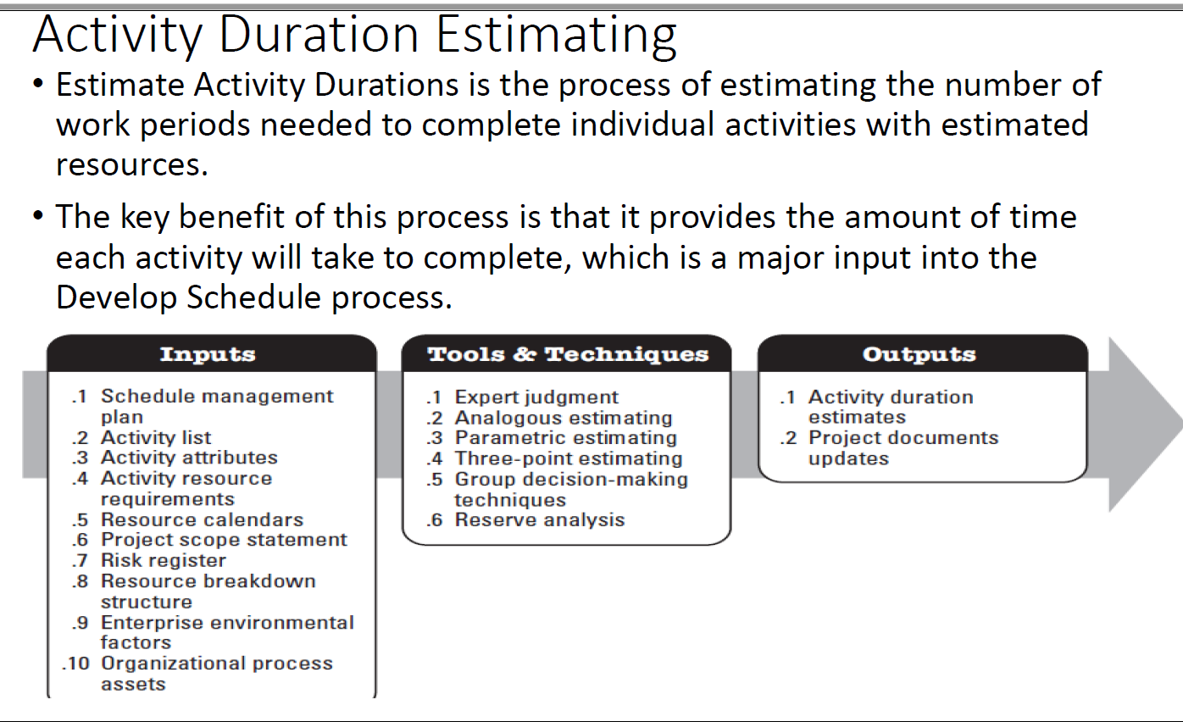

Slide 13
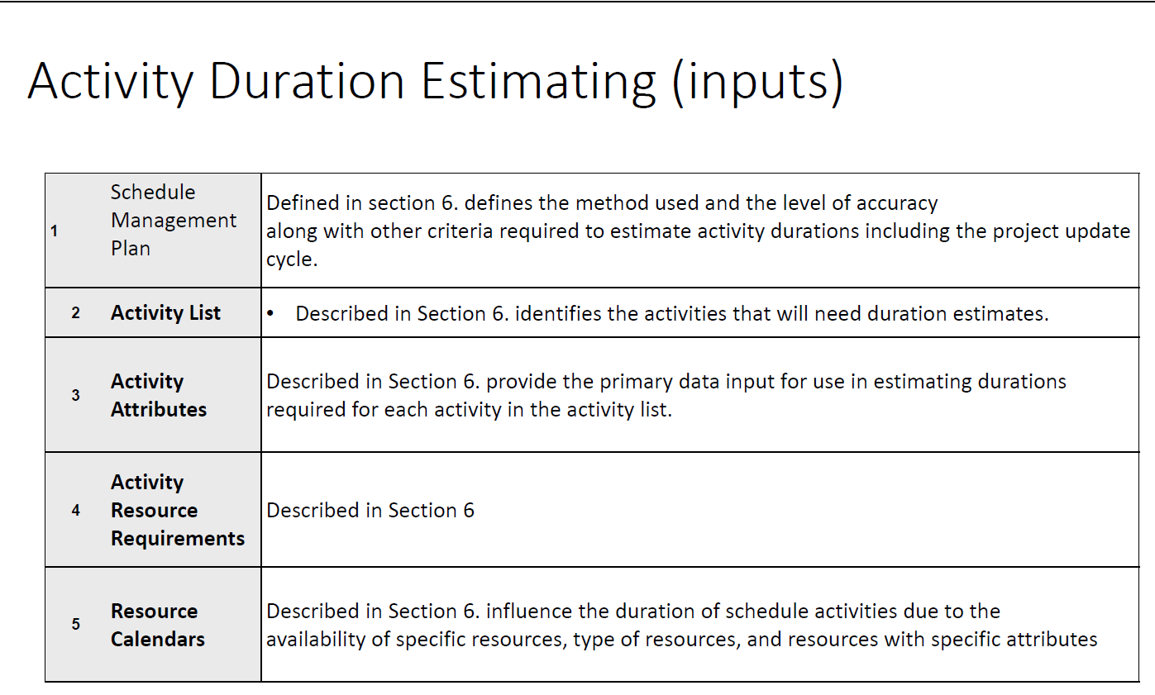

Slide 14
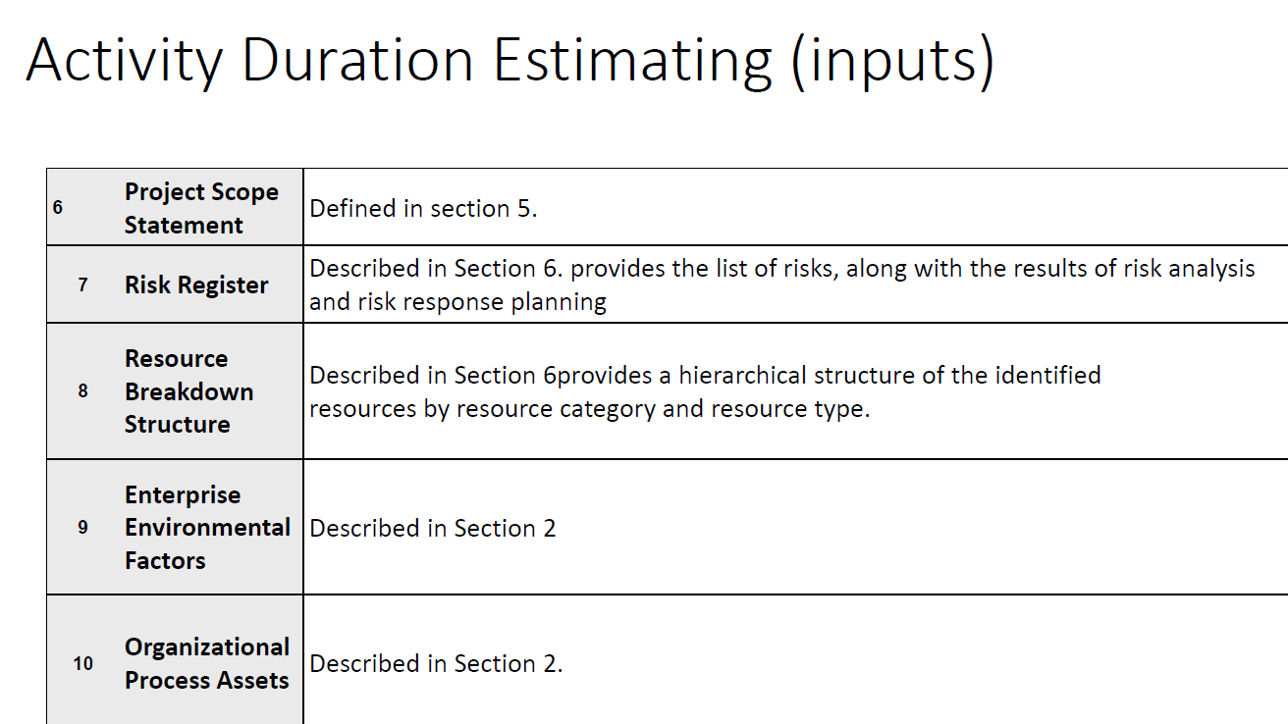

Slide 15
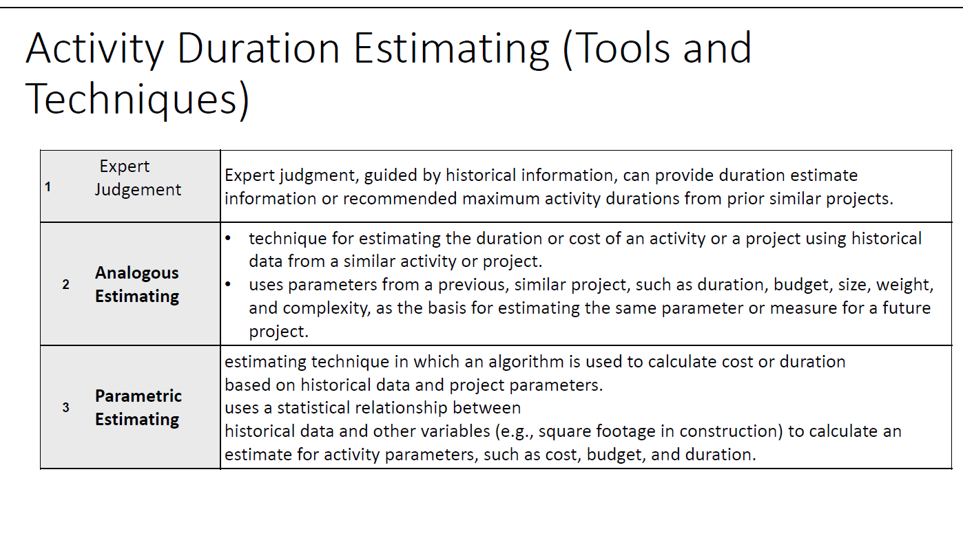

Slide 16
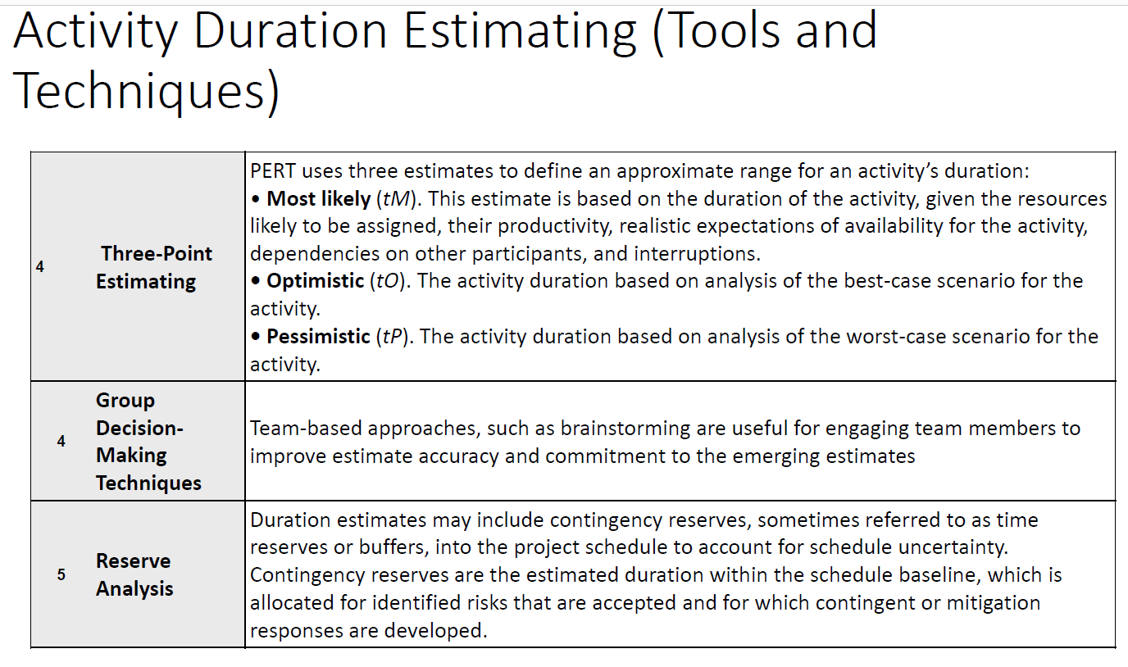

Slide 17
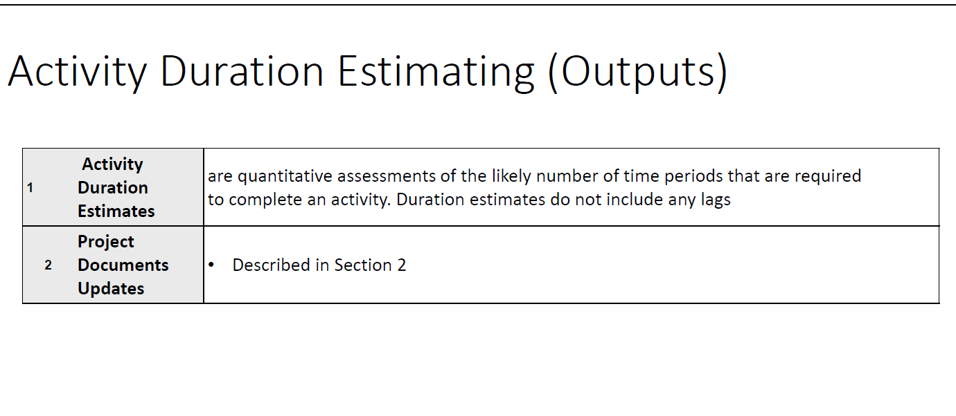

Slide 18
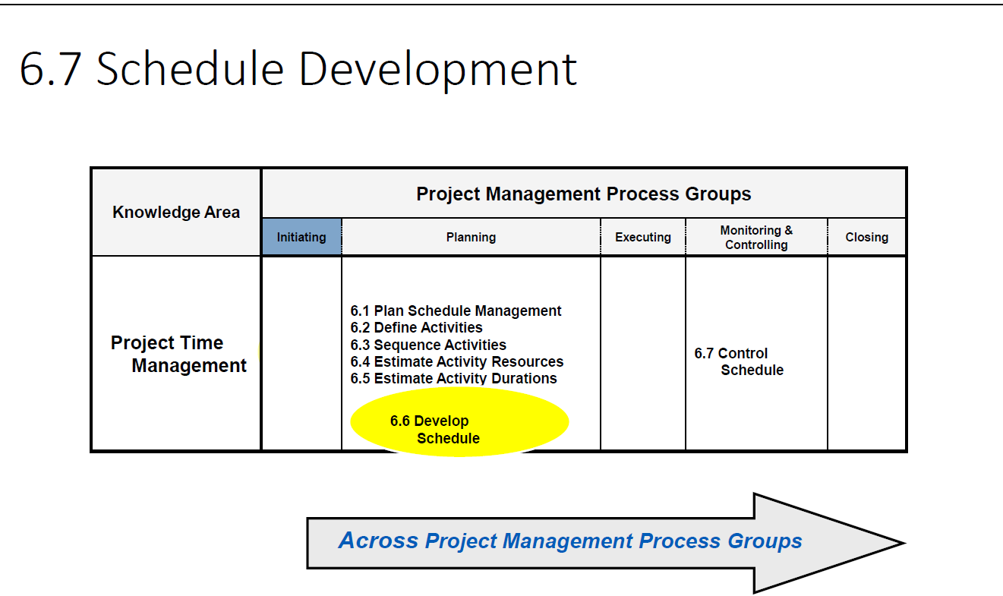

Slide 19
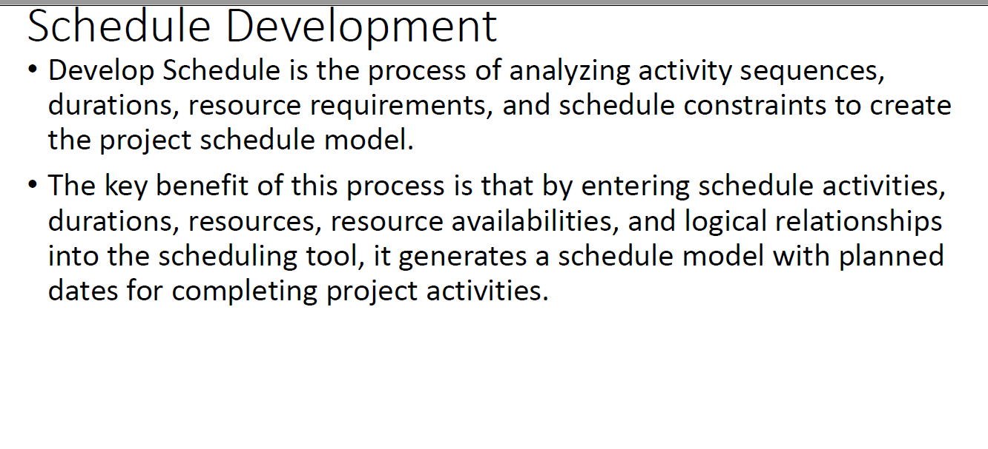

Slide 20
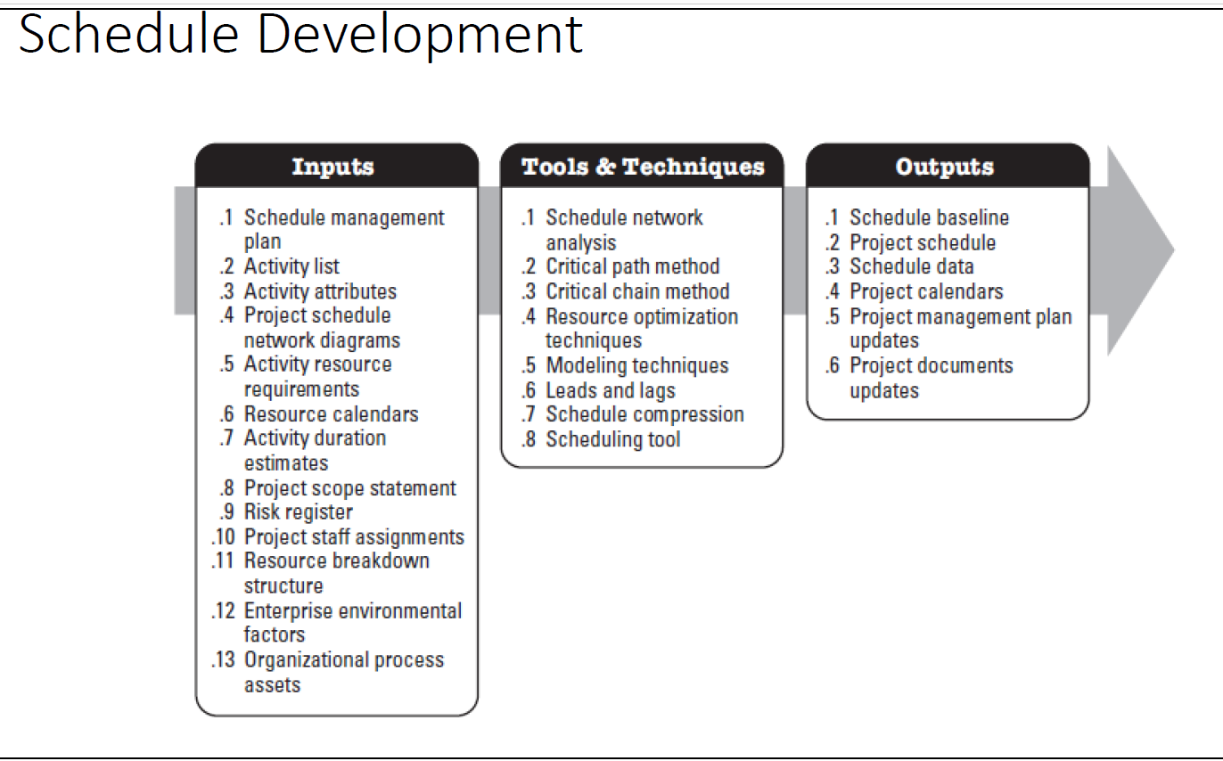

Slide 21
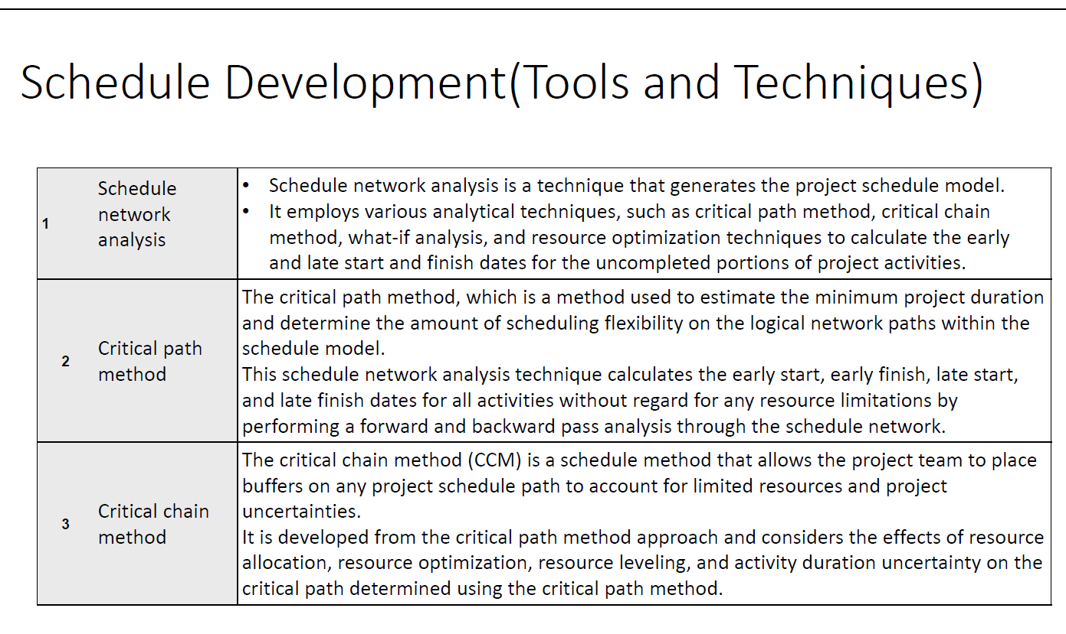

Slide 22
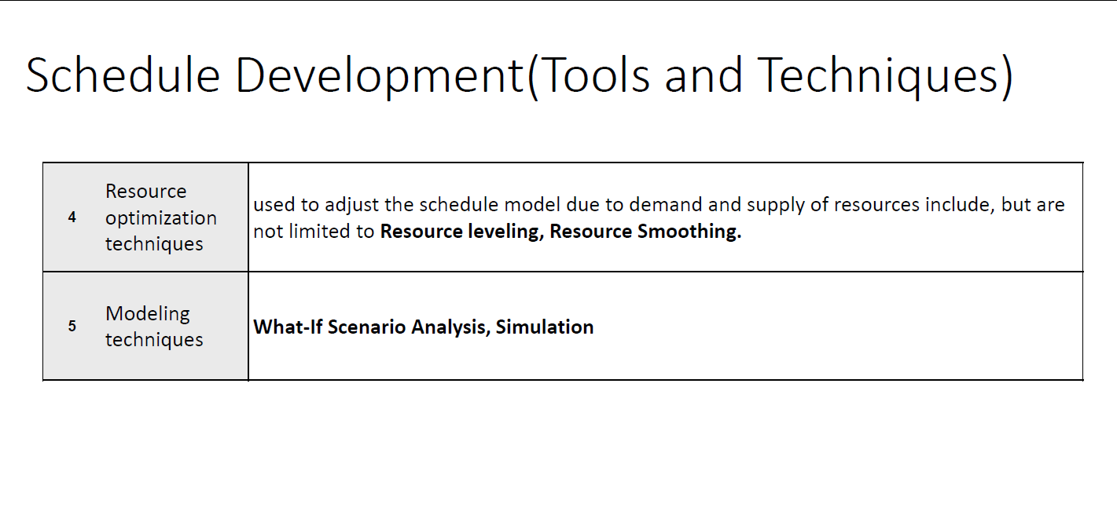

Slide 23
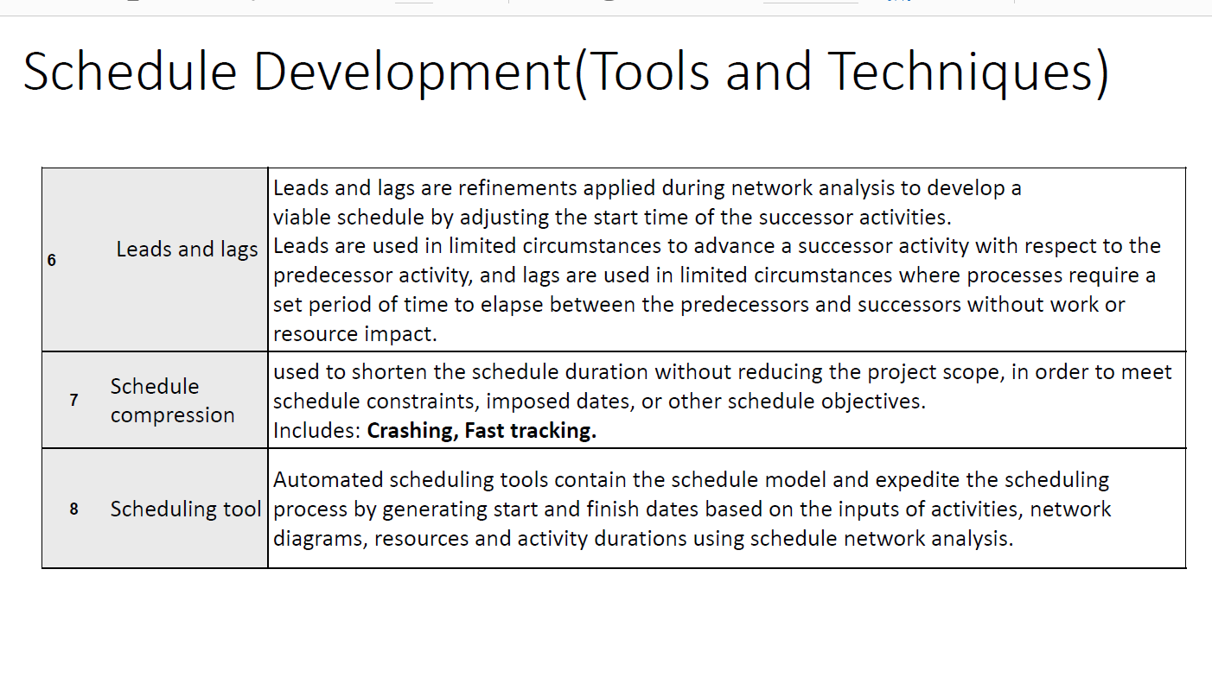

Slide 24
